Slide 1
Paysafe Challenge

Slide 2






Tools

Slide 3
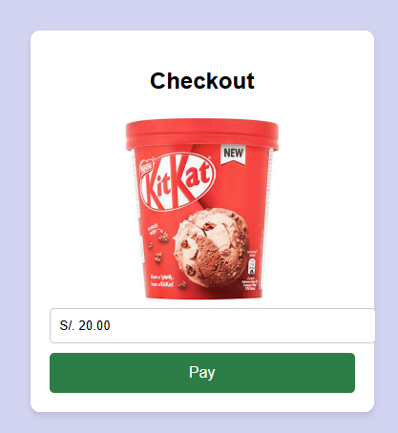
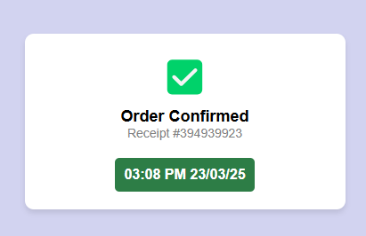
Screens

Slide 4
Process
Web App
Stripe’s Payment gateway
Stripe’s Webhook
Local route :5000/webhook
Comerce
User goes to “pay” in checkout
User inputs requested information
Event is Created
Receive event and log it
Produce report

Slide 5
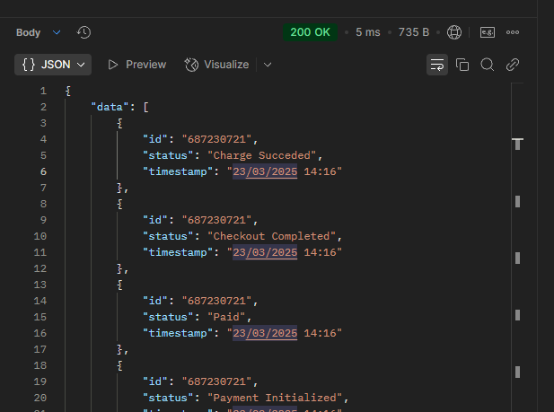
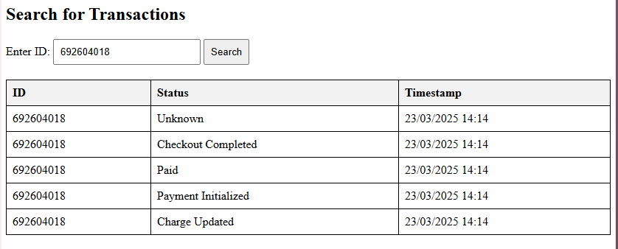
Report
Ruta http://127.0.0.1:5000/table?id=687230721

Slide 6
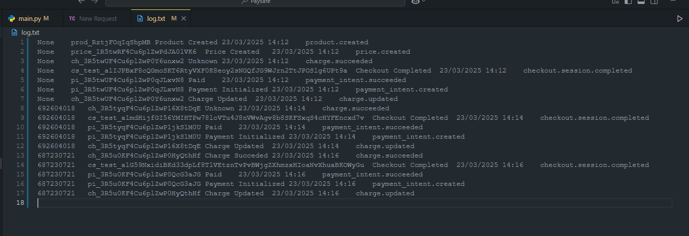
Example Data

Slide 7

Future Improvements
Column Name | Data Type | Constraints | Description
id | INTEGER | NOT NULL | User ID
transaction_id | TEXT | PRIMARY KEY | Unique Transaction Identifier
status | TEXT | NOT NULL | Transaction Status
timestamp | DATETIME | NOT NULL | Event Timestamp
event_type | TEXT | NOT NULL | Type of Event (e.g., charge.succeeded)

